Slide 1

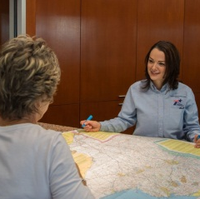



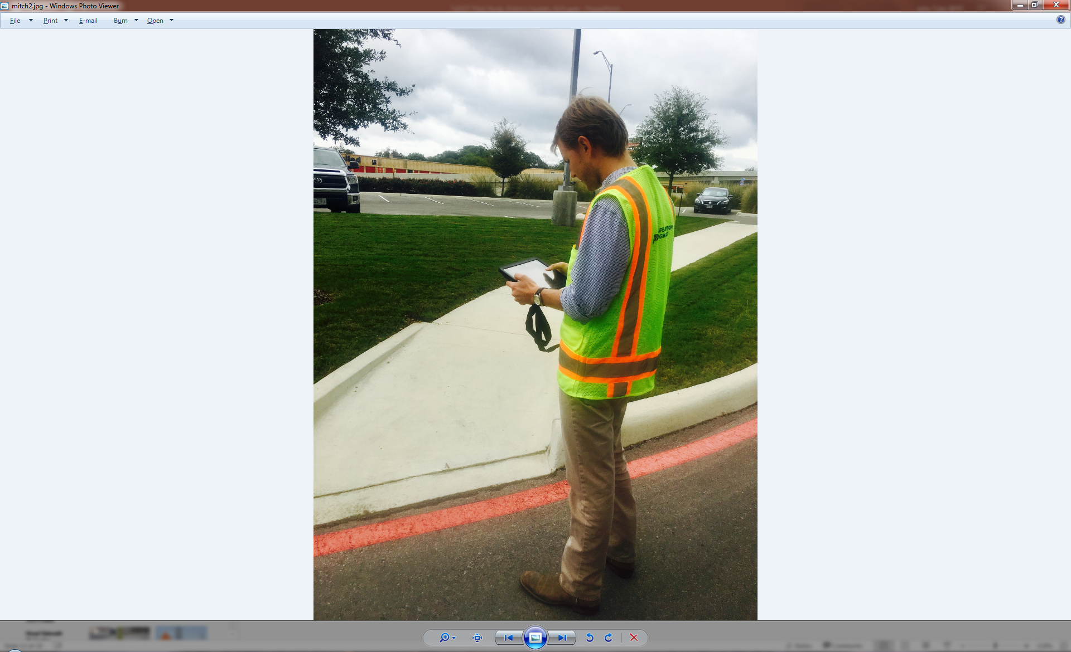
Txdot comprehensive accessibility program district engagement – El PAso
Improving Accessibility in Public Rights of Way
Winter 2023

Slide 2
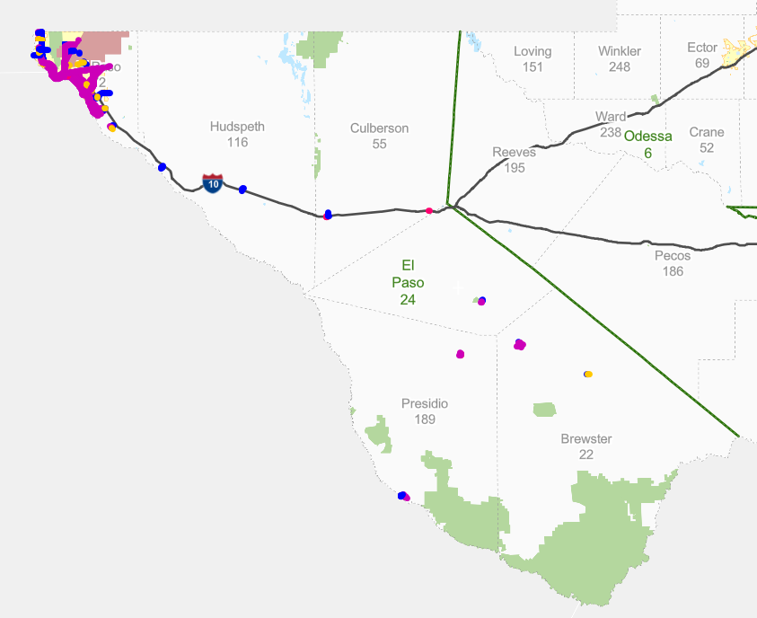
The State’s Commitment to Accessibility
Agenda
Goals, Introductions, Background
Safety Moment
Overview of TCAP and Transition Plan
What is TCAP and Phases
Purpose of Engagement
TCAP Web Interface Review
Project Tracking and Development
District Workflows
Points of District Contact
Next Steps
Mapping of Corridor Scoring

Slide 3

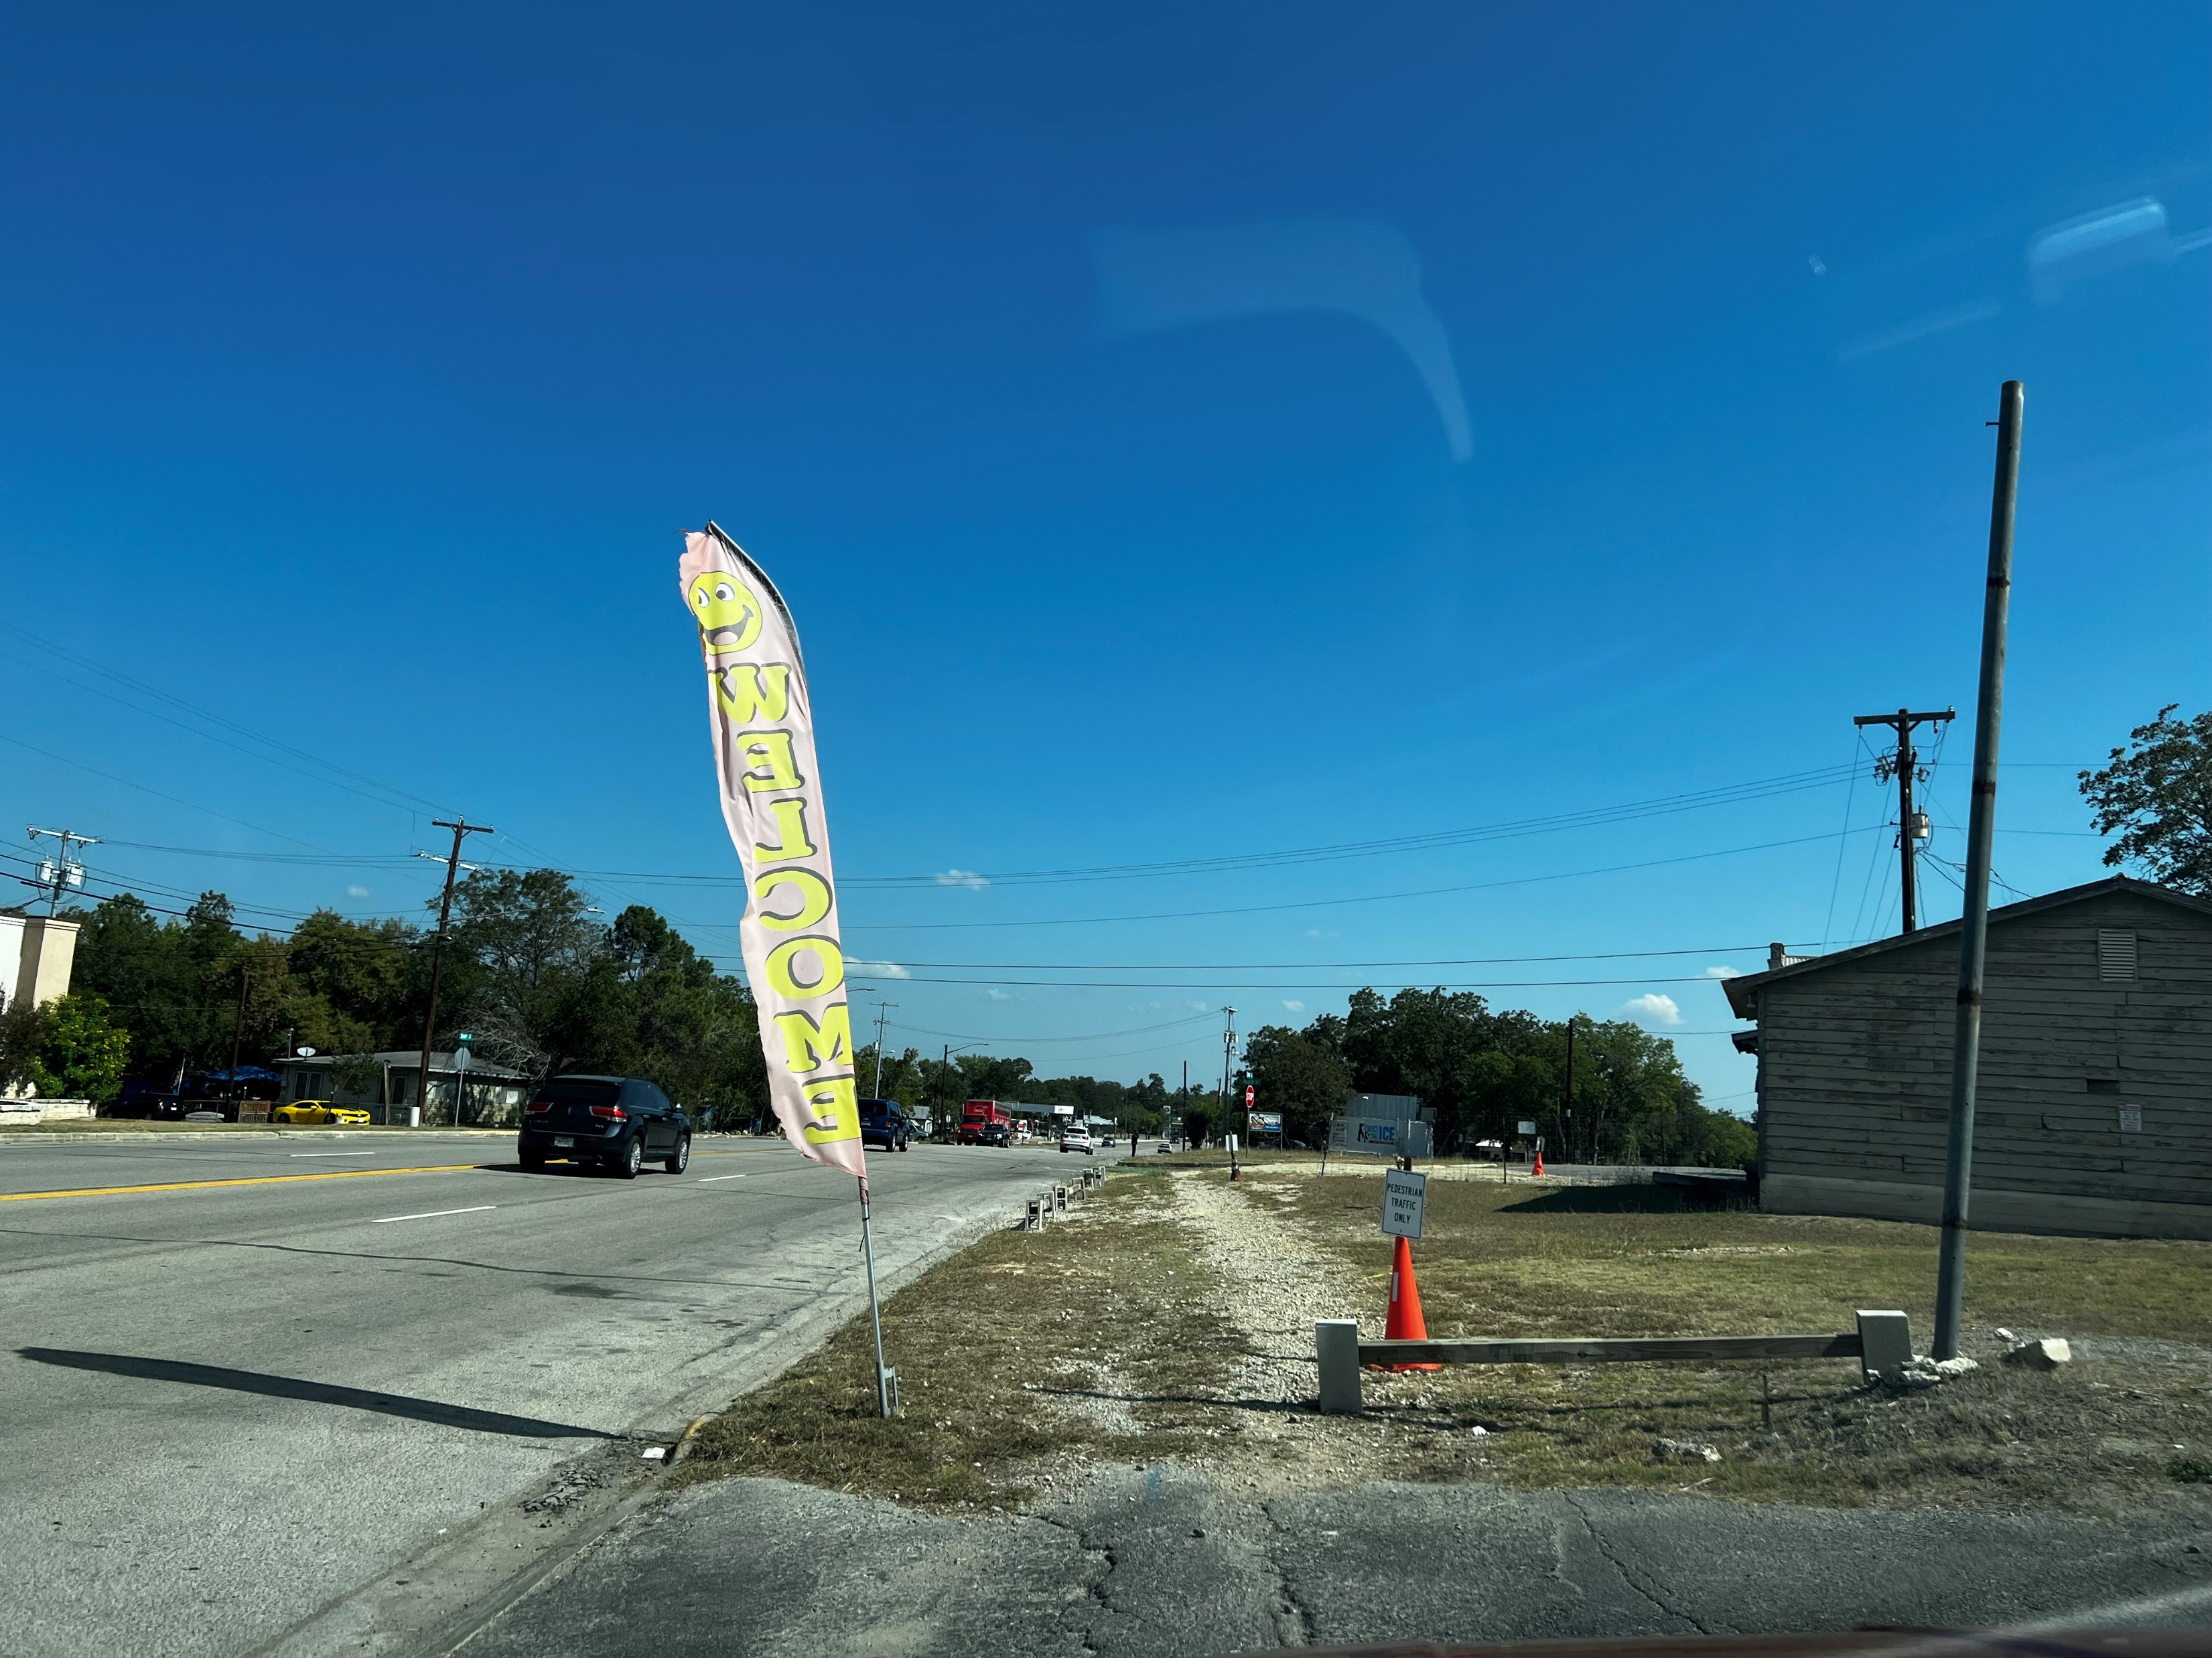
The State’s Commitment to Accessibility
  Safety Moment
Connectivity is not just for vehicles

Slide 4
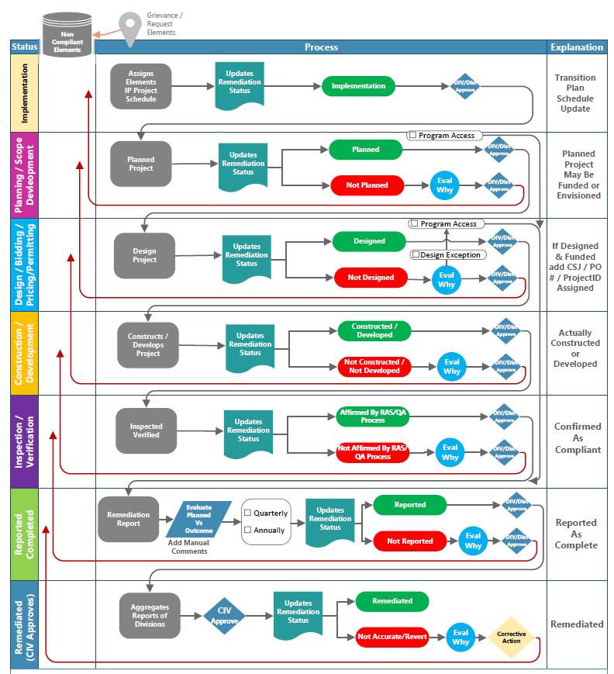
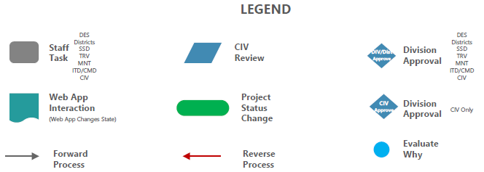
The State’s Commitment to Accessibility
TCAP Workflows
Project Development
Planning
Design / Letting
Construction
Inspection
User Credentials
View Only
Project Creator / Planner
Approval
Project Closeout
Verification and Acceptance
CIV Reporting
Project Duration

Slide 5
The State’s Commitment to Accessibility
TCAP Workflows
TxDOTConnect Workflows
Project Development
Planning
Design / Letting
Construction
Inspection
User Credentials
View Only
Project Creator / Planner
Approval
Project Closeout
Verification and Acceptance
CIV Reporting
Implementation
Execute
Initiate
PD
Planning
Planning
Pre-Procurement
Procurement
Design
Ready to Let
PS&E
Construction
Construction
Inspection
Closed
Remediation
Project Duration

Slide 6
The State’s Commitment to Accessibility
TxDOT Comprehensive Accessibility Program (TCAP)
Geospatial inventory of all noncompliant pedestrian accessible elements contained within the Pedestrian Access Inventory database (PAI).
TCAP’s PAI comprises ADA assets within the public ROW and was completed in June 2021 and includes 100% collection of accessibility elements within the ROW
Additionally houses geospatial inventory of TxDOT owned or leased buildings and facilities identified as a localized point.
Creates a space for remediation tracking, project development, cost estimation creation, and reporting of ADA remediation workflows
System allows planners, designers, and maintenance personnel access to information to make informed decisions related to ADA deficiencies and program remediation work into their projects.
Formal name of the Web Application (WebApp or TCAP WebApp) which references an ArcGIS system housing the PAI data, facility data, notations of locations for grievances, and reporting.
Pedestrian
Access
Inventory
Buildings Facilities

Slide 7
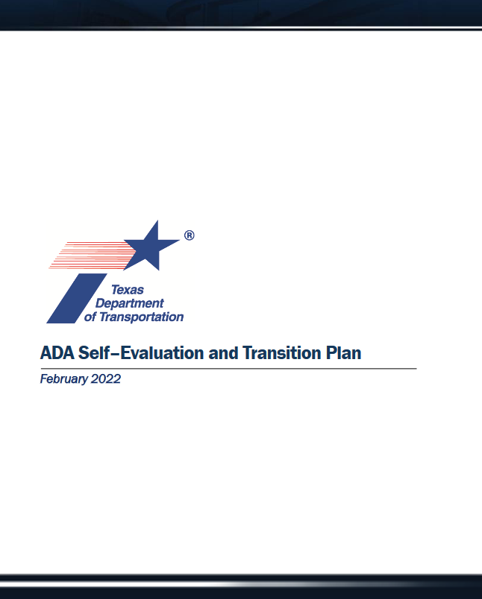

The State’s Commitment to Accessibility
Pedestrian
Access
Inventory
ADA Liaisons
TCAP
Web Application
Policy Practice Services
Buildings Facilities

Slide 8
The State’s Commitment to Accessibility
District Engagement Overview
Phase 1 – District support, capture changes from original inventory, create processes internally, plan projects, training
Phase 2 – Field analysis and verification, inspection oversight / training / best practices, additional inventory not included in TCAP
Phase 3 – Field design support services
Phase 1 Training Overview
101 TCAP Analysis and Planning
  Audience: All project stakeholders responsible for scoping, limits, and estimation
102 TCAP Project Creation and Development
  Audience: Staff responsible for review, design, planning, or tracking projects
103 TCAP Approvals and Reporting
Audience: Administrative delegates responsible for project acceptance and approval

Slide 9
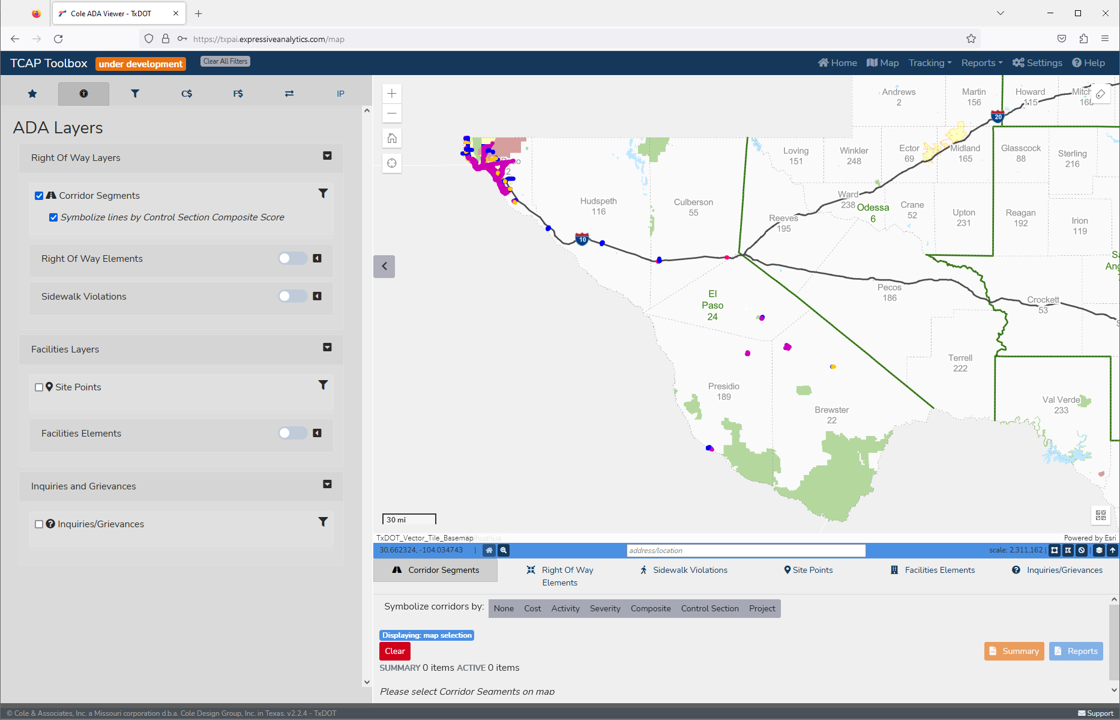
The State’s Commitment to Accessibility
Process Development
Field Collections
Processing
Prioritization
Project Development
Stakeholder Engagement
Transition Plan Integration
TCAP
Today
TCAP Web Application

Slide 10
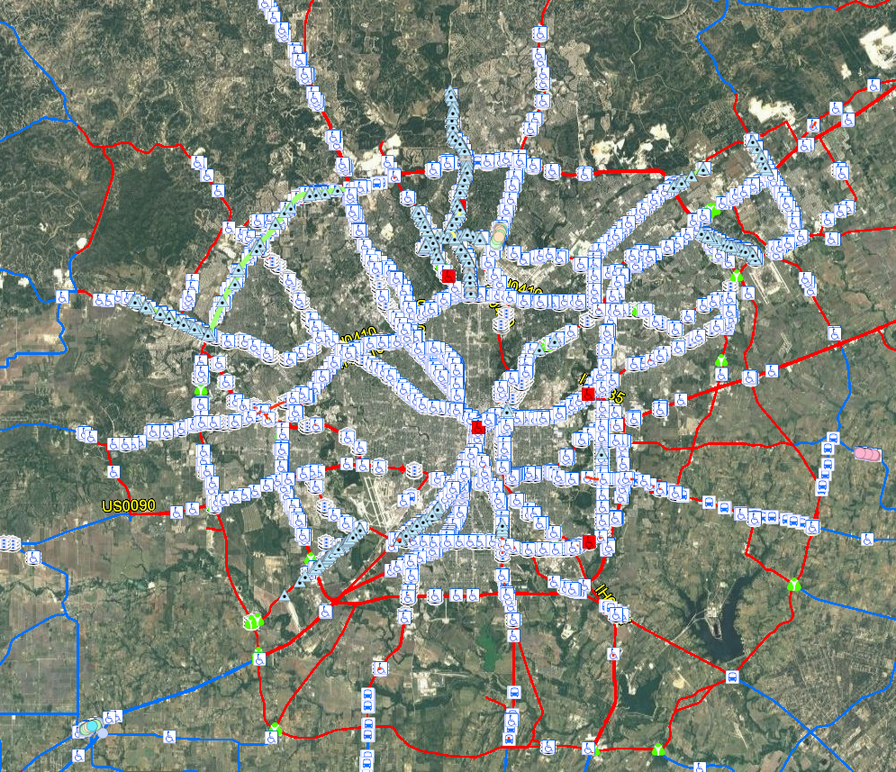
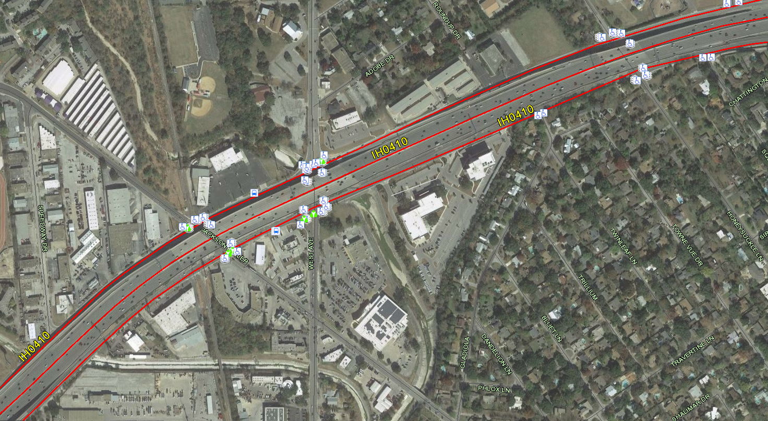
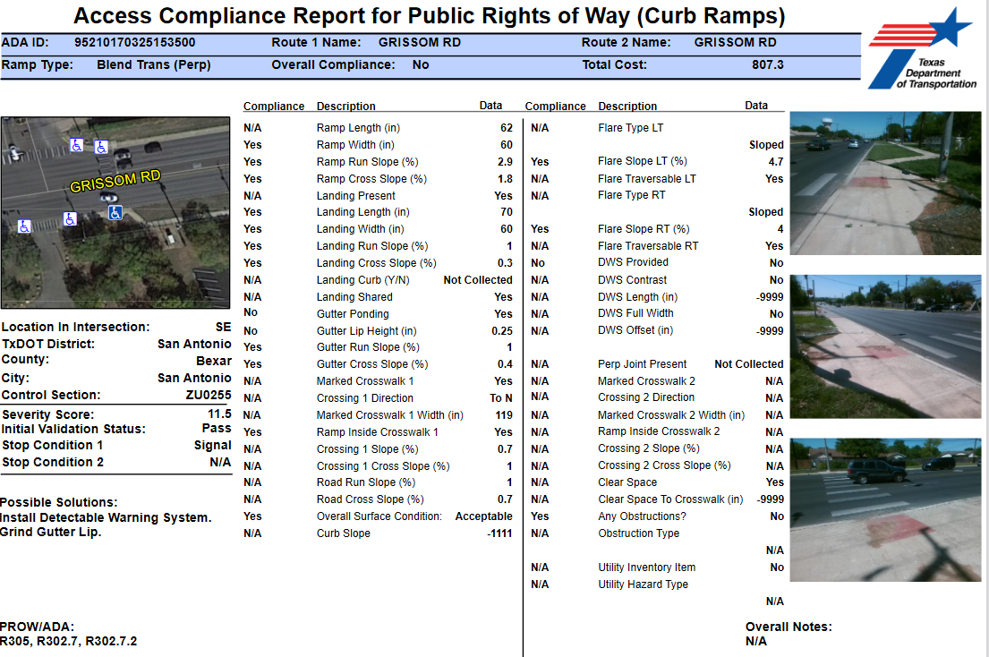
The State’s Commitment to Accessibility
Data Collection Methodology
Collected Feature | Collection Parameters
Curb Ramps | measurements taken for all ramps elements
Transit | ADA measurements taken for all transit stop linear elements, noted additional features
Push-Buttons | measurements and orientation of push-buttons

Slide 11
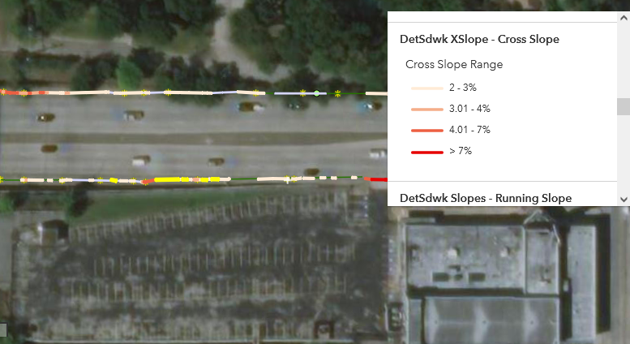
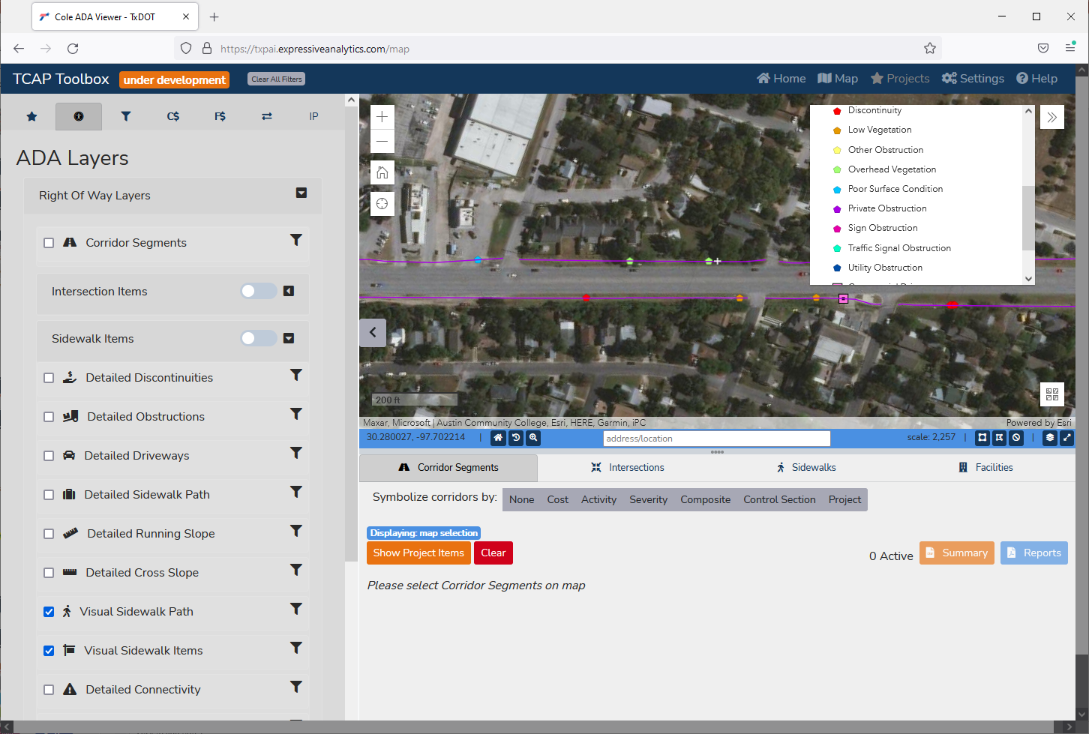
The State’s Commitment to Accessibility
Data Collection Methodology
Collected Feature | Collection Parameters
Visual Sidewalk | Linear GPS tablet enabled work flow with video documentation
Detailed Sidewalk | Linear methods to produce “continual calculations”
Gaps, Missing, Transit Connection | Linear segments documented in database
Detailed Sidewalk Collection
Visual Sidewalk Collection

Slide 12
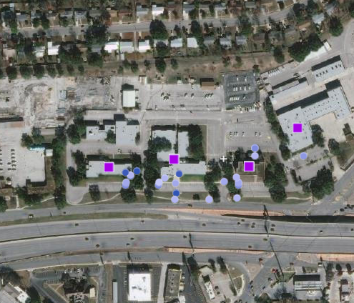
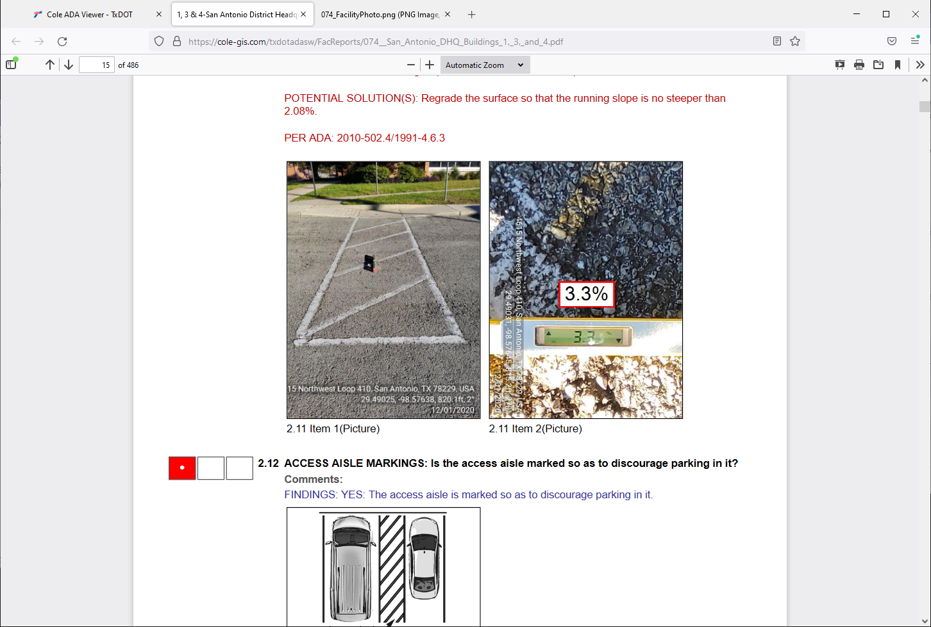
The State’s Commitment to Accessibility
Facility Collection Methodology
Collected Feature | Collection Parameters
Site Points | Organized by each facility
Building Points | Floor, Elements, Path of Travel
Exterior Points | Level, Elements, Path of Travel
Facility Collection
Facility Report

Slide 13
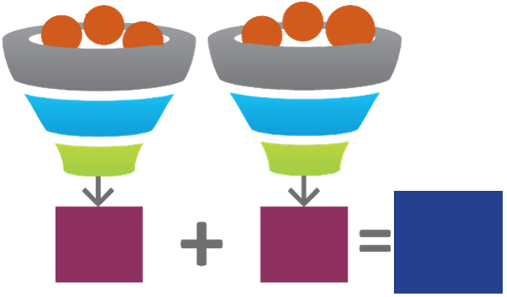
The State’s Commitment to Accessibility
Slope
Gov.
Bldgs.
Bus Stops
Schools
Heaves
Obs.
Severity
Score
(#)
Activity
Score
(#)
Total Score
(#)
TCAP Scoring Matrix
A
B
C
D
F

Slide 14
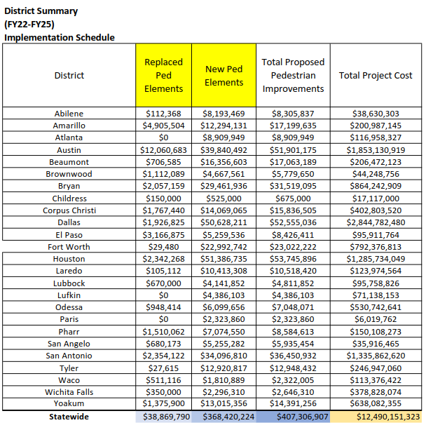
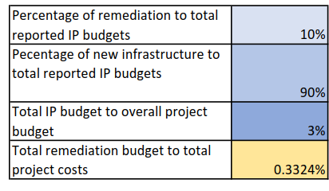
The State’s Commitment to Accessibility
Statewide Overview
.3112%
3% is light. Generally, if scrutinized, TxDOT needs this number higher and at +/- 10%
This number represents TxDOT’s true projected remediation in this current cycle. True remediation of the projects eligible and in the IPs should be closer to 10% - will not happen over night OR without a proper plan

Slide 15
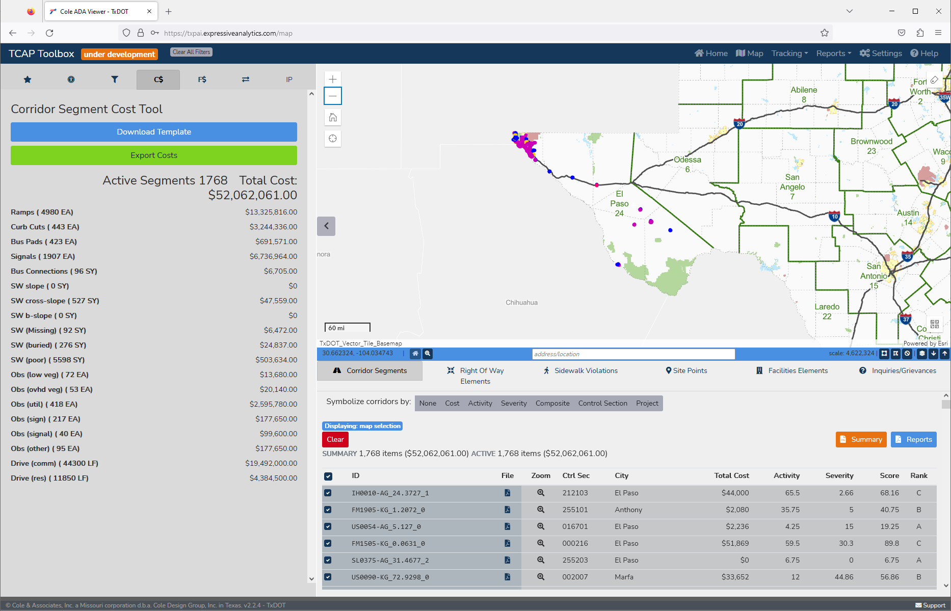
The State’s Commitment to Accessibility
District Overview
District Elements Requiring Remediation
Dist. Number | 24
Dist. Name | El Paso
Dist. Abbv. | ELP
A | $ 5,953,805
B | $ 14,835,657
C | $ 18,050,972
D | $ 10,674,924
F | $ 2,546,703
Total | $ 52,062,061
Corridor Segment Counts
A | 317
B | 499
C | 528
D | 353
F | 71

Slide 16
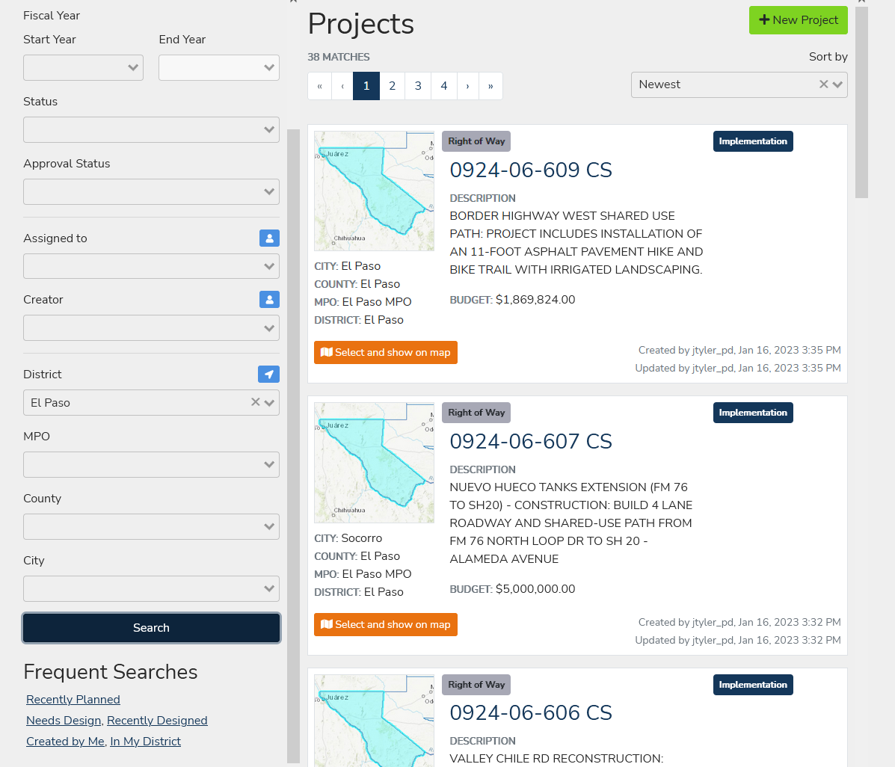
The State’s Commitment to Accessibility
Project Development
Develop project remediation within the Projects Toolkit
Serves as a central location for project creation, scoping, planning, and tracking
Initializes project workflows and reporting
Provides direct integration with the Transition Plan for reporting progress and providing logic of non-improved areas
User access and approval capacity is developed based on identified level of project integration and credentials

Slide 17
The State’s Commitment to Accessibility
Live DEMO

Slide 18
The State’s Commitment to Accessibility
TCAP Workflows
Project Development
Planning
Design / Letting
Construction
Inspection
User Credentials
View Only
Project Creator / Planner
Approval
Project Closeout
Verification and Acceptance
CIV Reporting
Project Duration

Slide 19
Question & Answer
Schedule

